Slide 1
data Structure and algorithm
Lecture#15

Slide 2
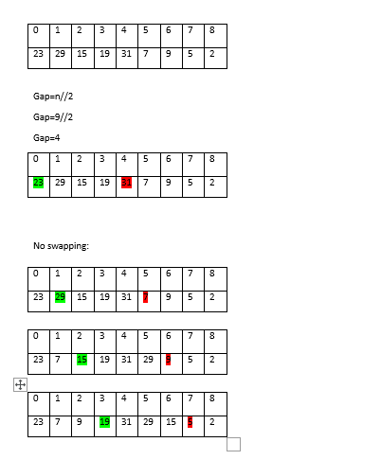
Shell sort

Slide 3
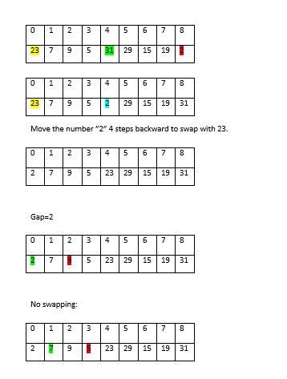
Cont…

Slide 4
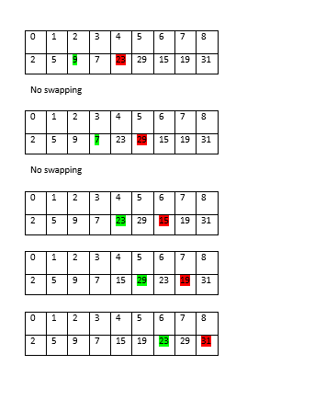
Cont…

Slide 5
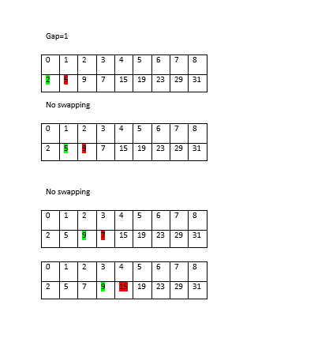
Cont…

Slide 6
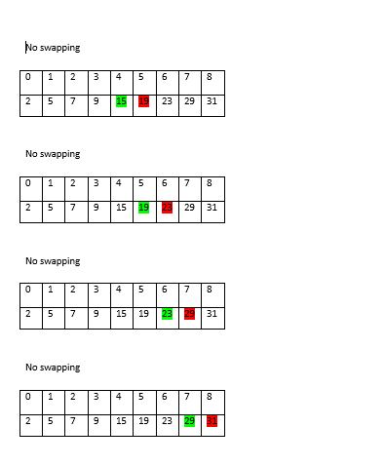
Cont…

Slide 7
Class Assignment
Consider an array of length 8 and then sort the array through shell sort technique.

Slide 8
Radix sort
Input list: 126, 328, 636, 341, 416, 131, 328
Step-1: 341, 131, 126, 636, 416, 328, 328
Step-2: 416, 126, 328, 328, 131, 636, 341
Step-3: 126, 131, 328, 328, 341, 416, 636

Slide 9

Class Assignment
Consider the following array and then sort the array through radix sort technique:
Note:
For radix sort each element should consists of same number of digits

Slide 10
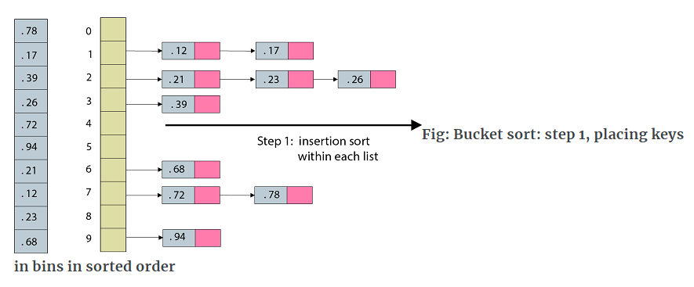
Bucket sort
A= = (0.78, 0.17, 0.39, 0.26, 0.72, 0.94, 0.21, 0.12, 0.23, 0.68)

Slide 11
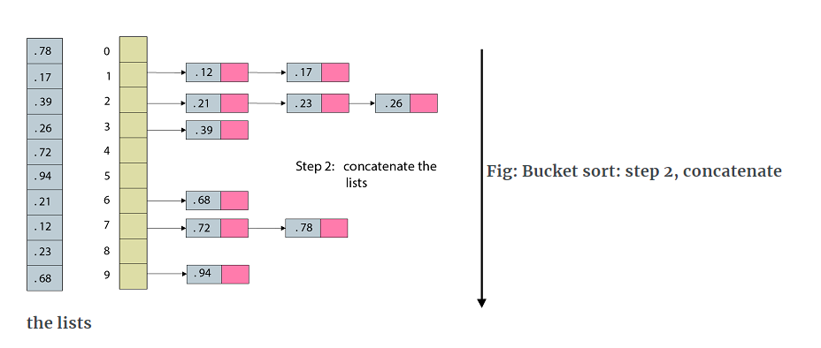
Cont…

Slide 12
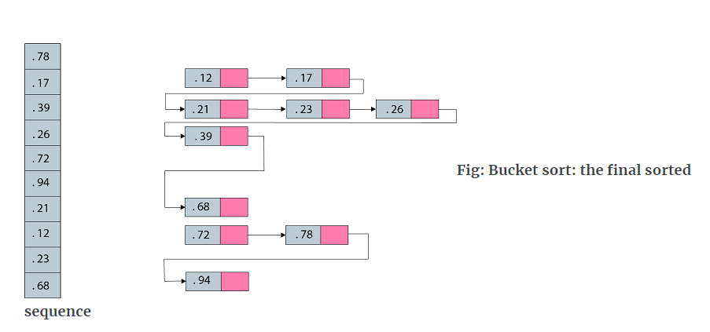
Cont...

Slide 13

Class Assignment
Apply bucket sort on the following array:

Slide 14
THANK
YOU

